Slide 1

Examination System
Power BI Developer Masoura Branch Feb.2023

Slide 2
Project Planning
Project Planning
Project Planning
Project Planning
Project Planning
Stored procedure
DataBase
ERD
Mapping
Reports
Business Scenario
Main Entity
Dashboard
Documentation

Slide 3
Business Scenario
An automated examination system which perform online exams by instructors and students to being automatically corrected based on questions bank and their model answers.
The examination system includes main entities which are the following
Student
Department
Branch
Instructor
Course
Exam
Questions

Slide 4
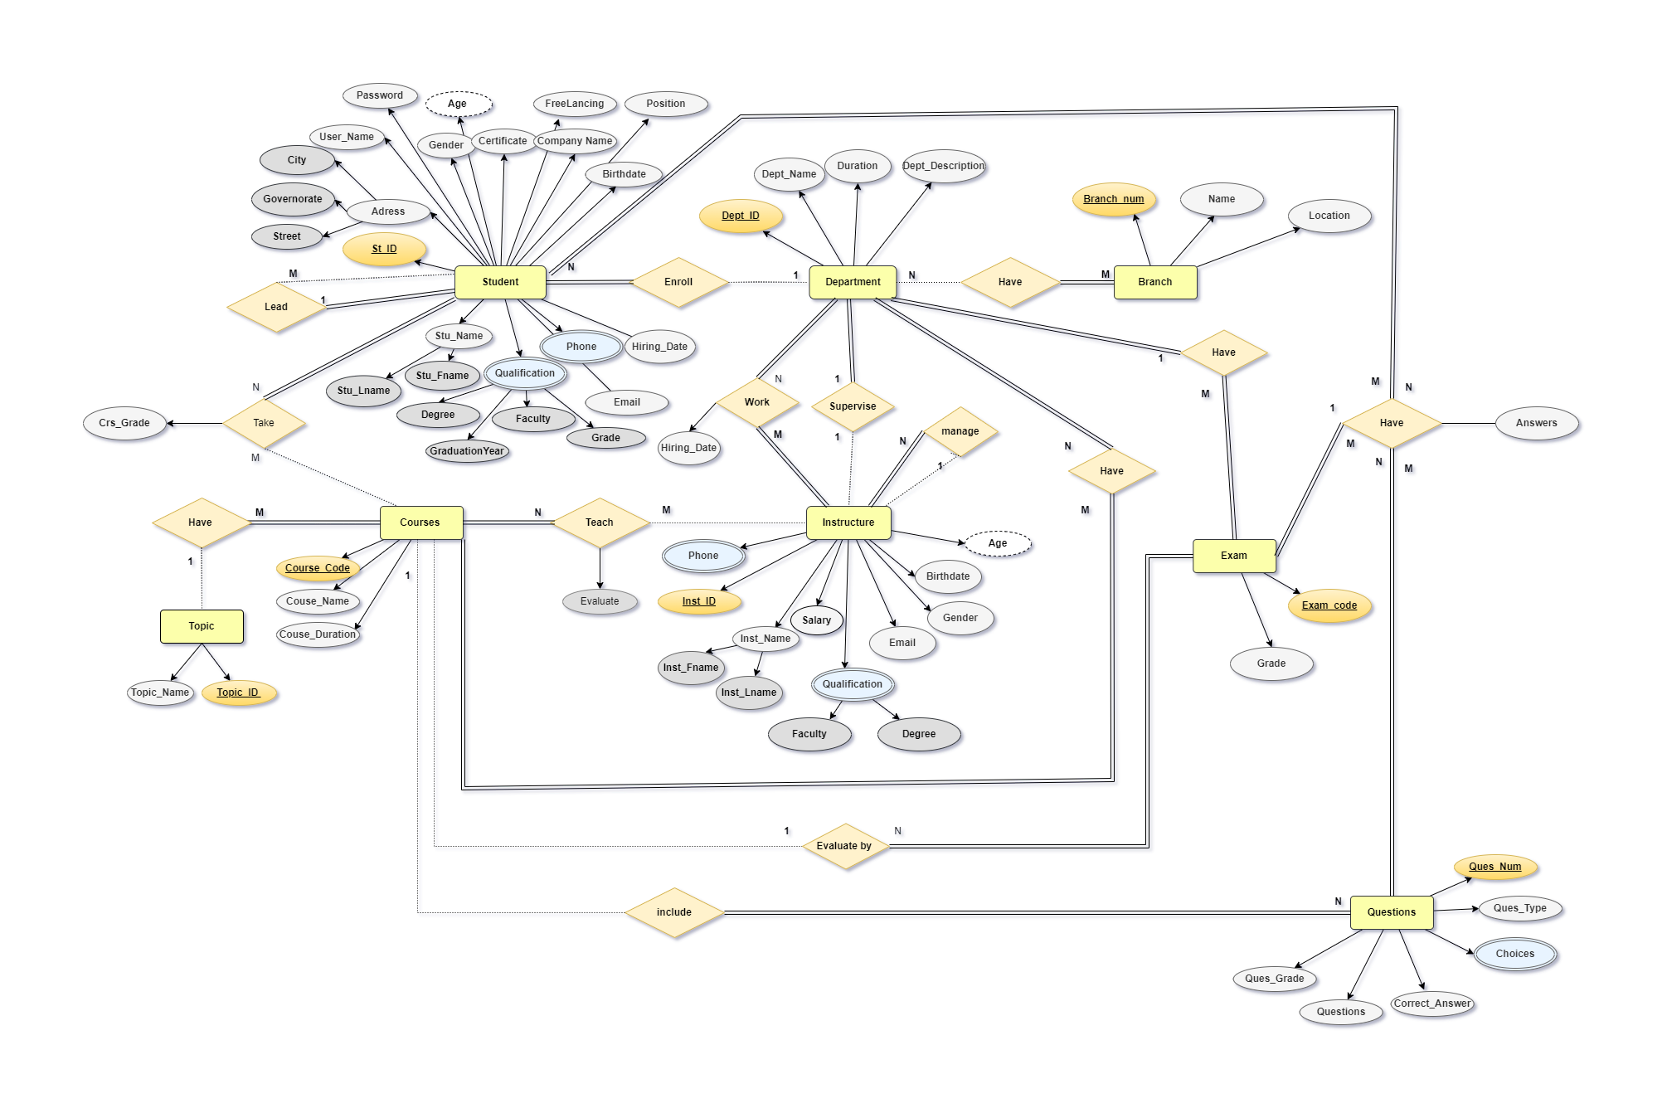
ERD

Slide 5
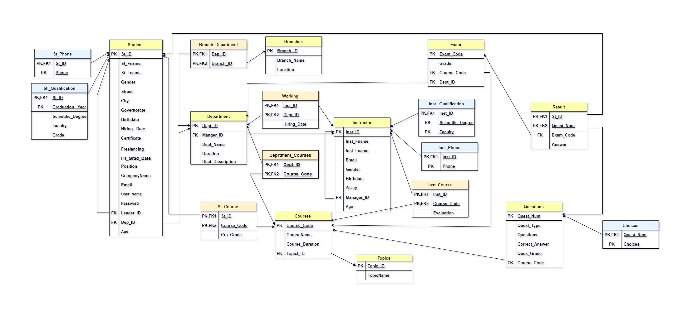
Mapping

Slide 6
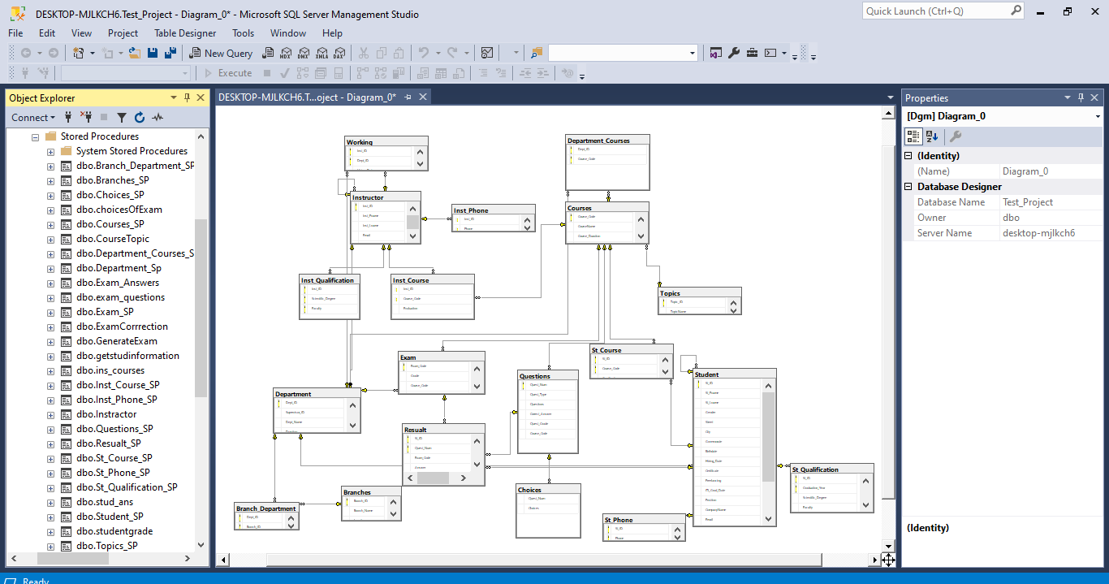
Database

Slide 7
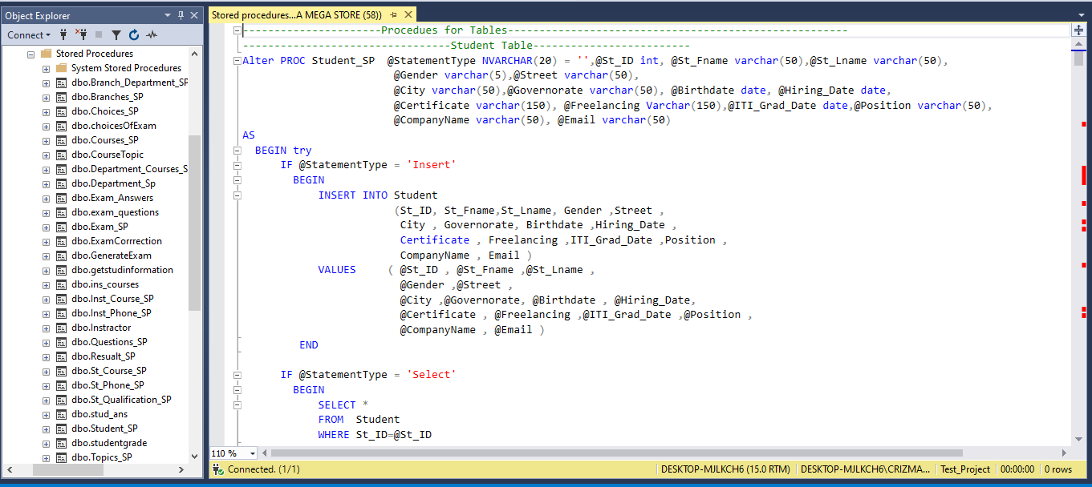
Stored Procedures
Basic procedures

Slide 8
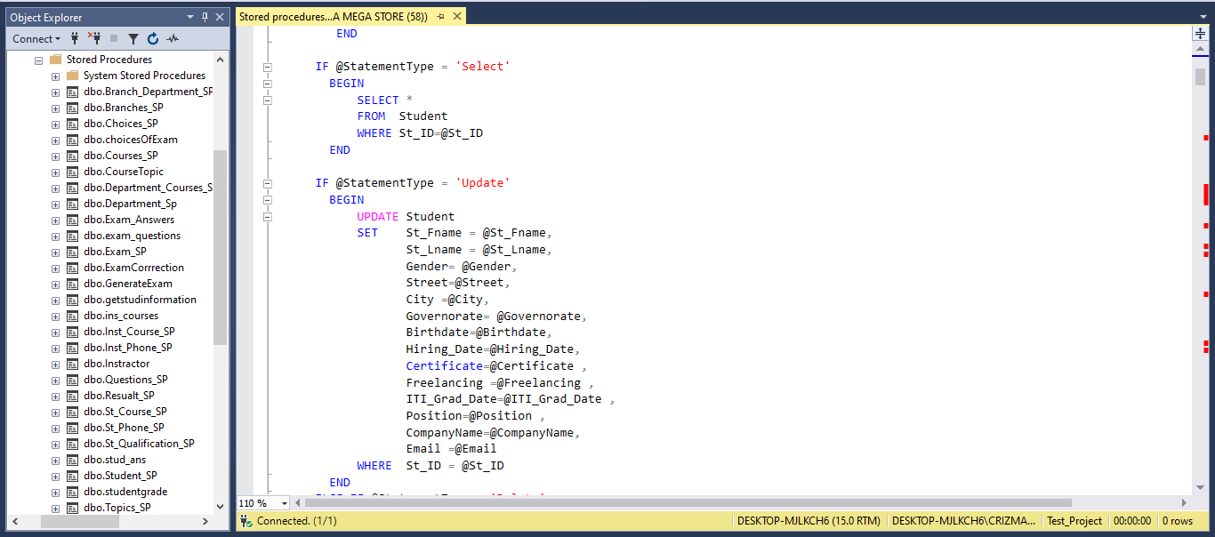
Stored Procedures
Basic procedures

Slide 9



Generate Data
Faker Function
Web Scrapping
Red Gate

Slide 10
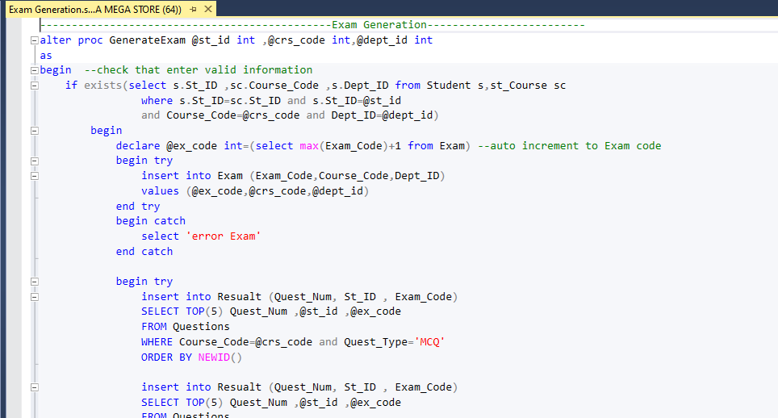
Stored Procedures
Exam procedures(Exam Generation)

Slide 11
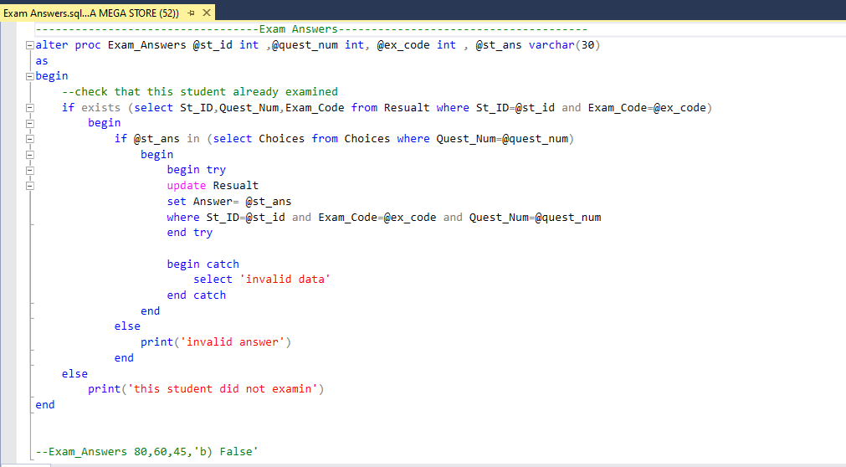
Stored Procedures
Exam procedures(Exam Answer)

Slide 12
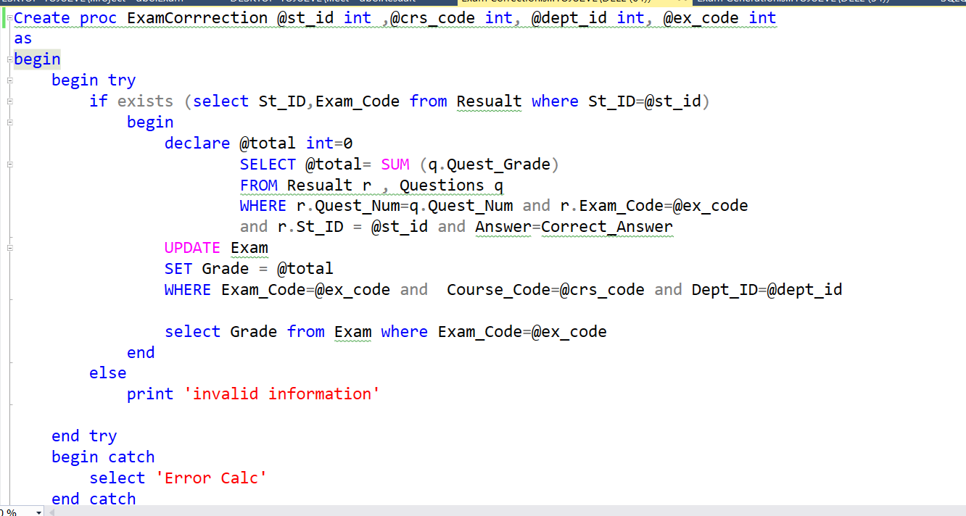
Stored Procedures
Exam procedures(Exam Correction)

Slide 13
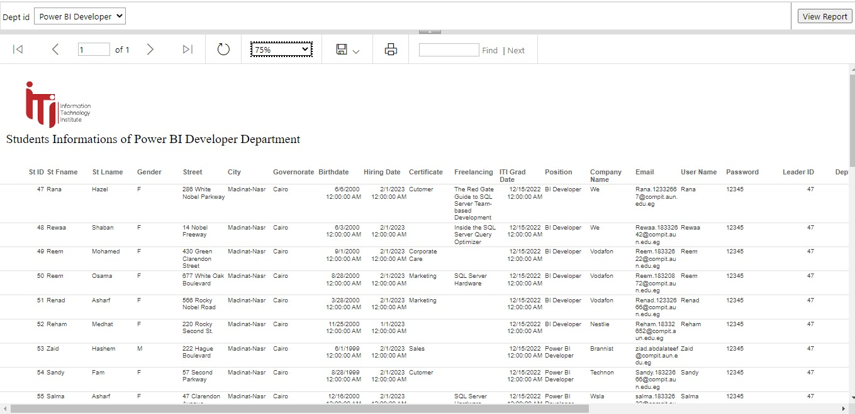
Reports
Report that returns the students information according to Department No parameter.

Slide 14
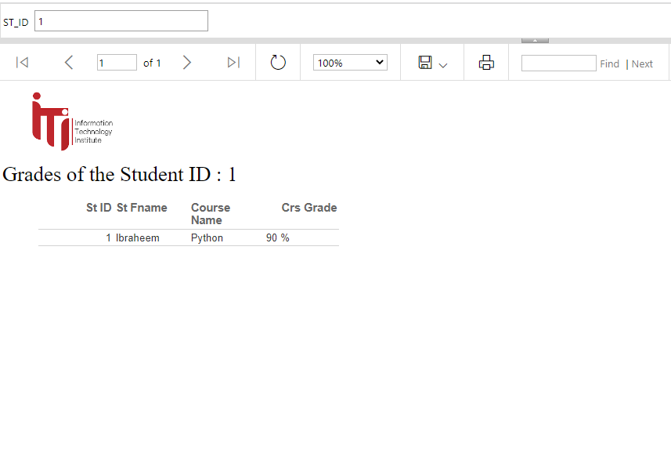
Reports
Report that takes the student ID and returns the grades of the student in all courses.

Slide 15
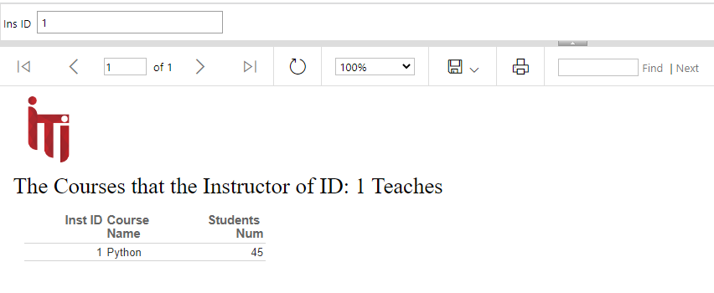
Reports
Report that takes the instructor ID and returns the name of the courses that he teaches and the number of student per course.

Slide 16
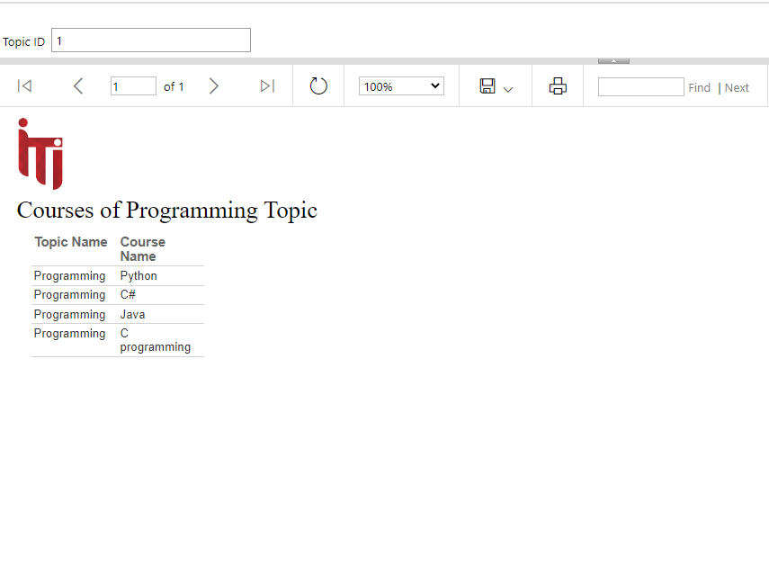
Reports
Report that takes course ID and returns its topics

Slide 17
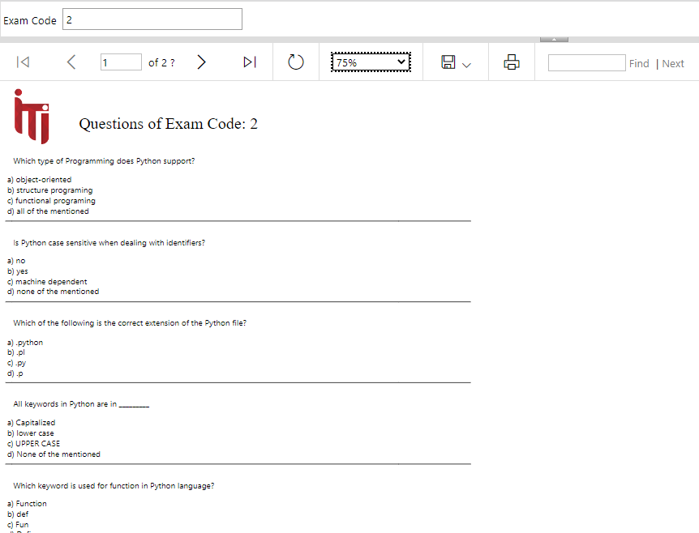
Reports
Report that takes exam code and returns the Questions in it and choices.

Slide 18
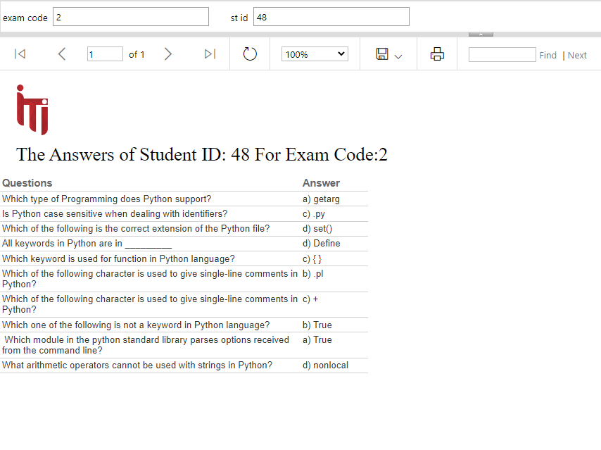
Reports
Report that takes exam number and the student ID then returns the Questions in this exam with the student answers.

Slide 19

Dashboard

Slide 20
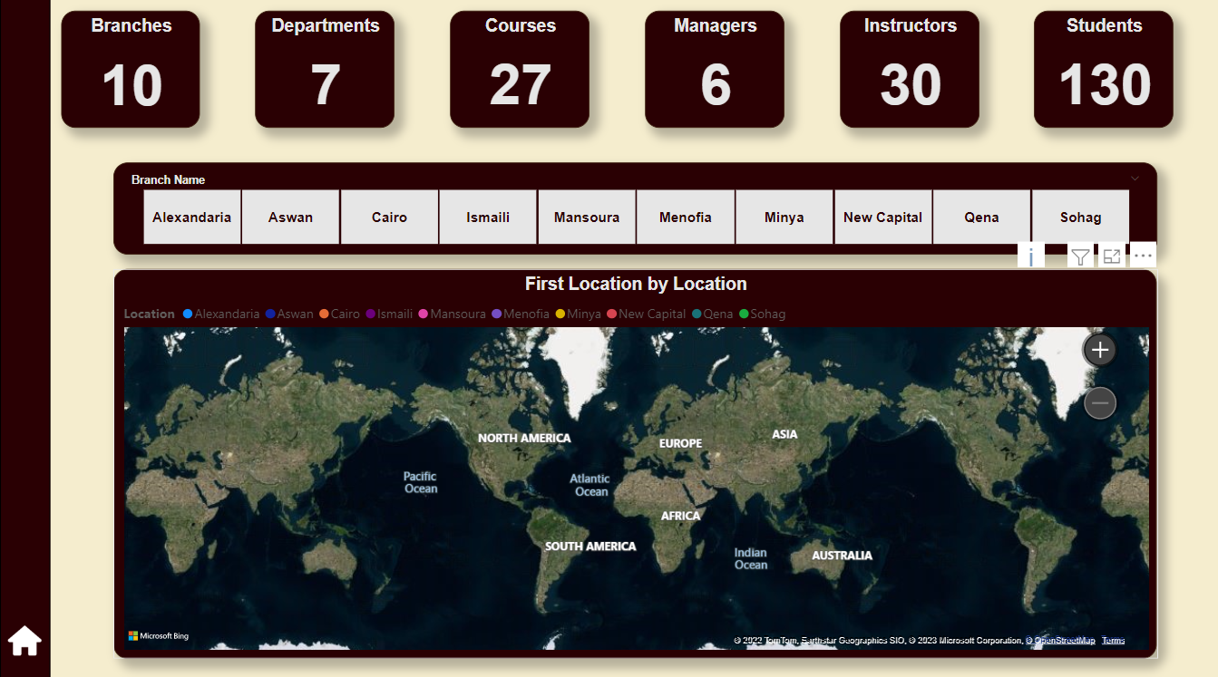
Dashboard

Slide 21
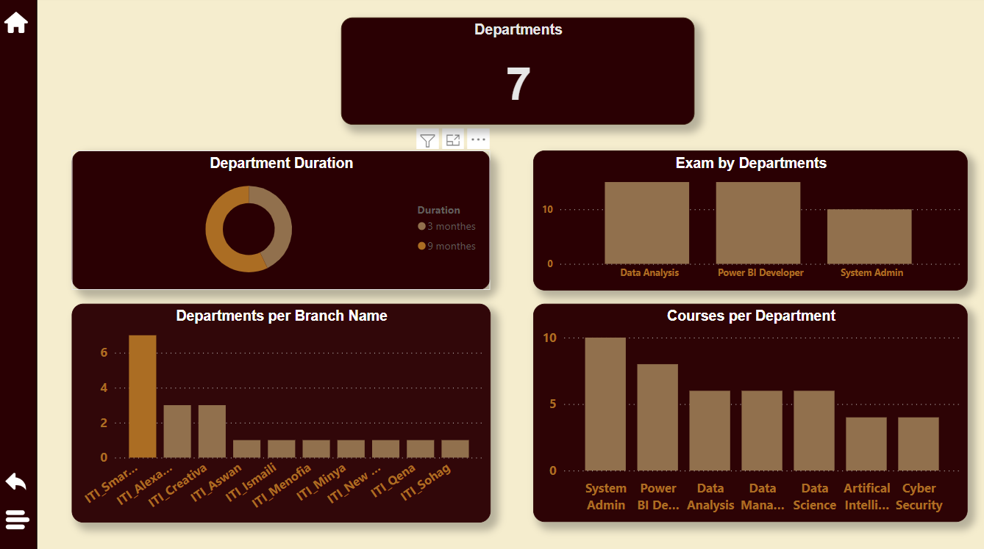
Dashboard

Slide 22
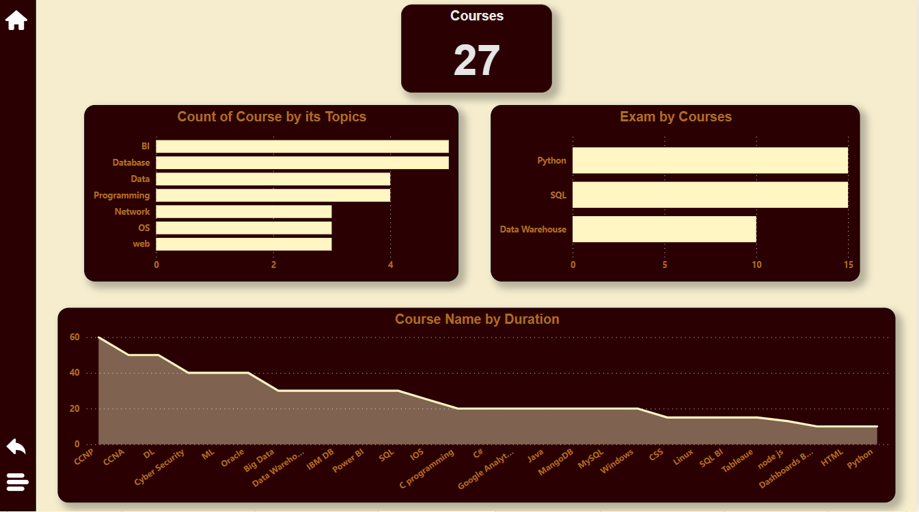
Dashboard

Slide 23
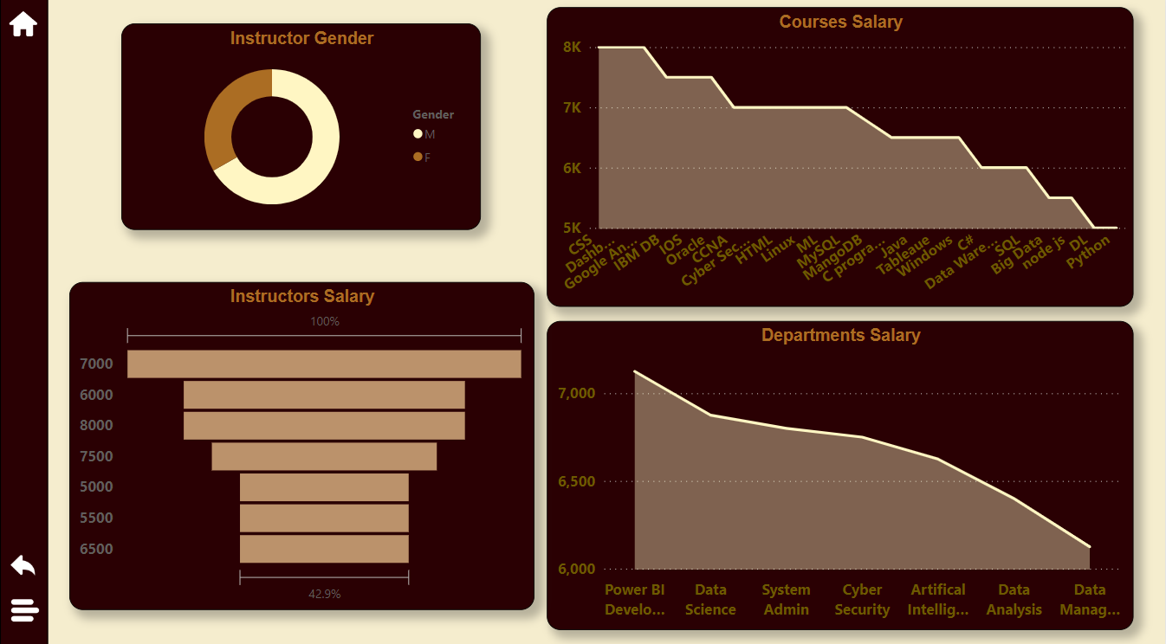
Dashboard

Slide 24
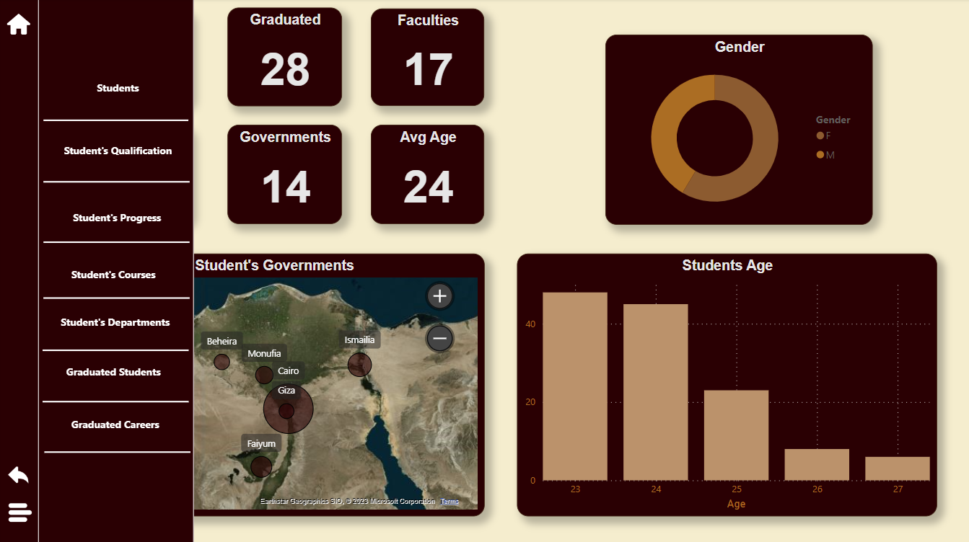
Dashboard

Slide 25
Examination System
Team Members
Shorok Mohamed Awatf Samir
Meran Ahmed Aml Kamal
Yasmeen Shamakh

Slide 26

Thank You

